Slide 1
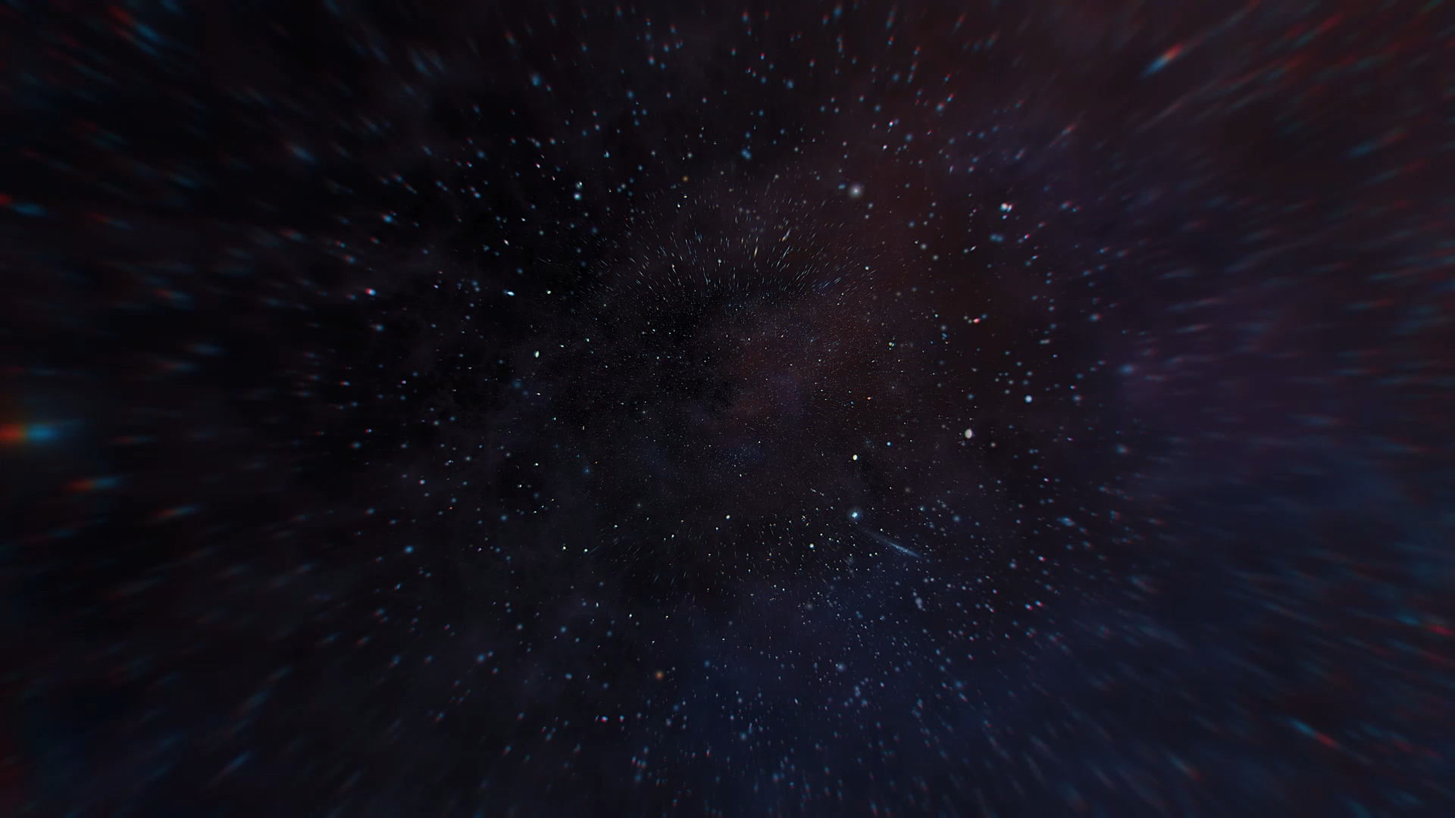
Are we alone in the Universe? Looking into the data behind the question by Andrew Scannell
Topics:
Introduction
How are we gathering data now?
The ’Wow!’ signal
Limitations to the data
What data can we gather in the future?

Slide 2
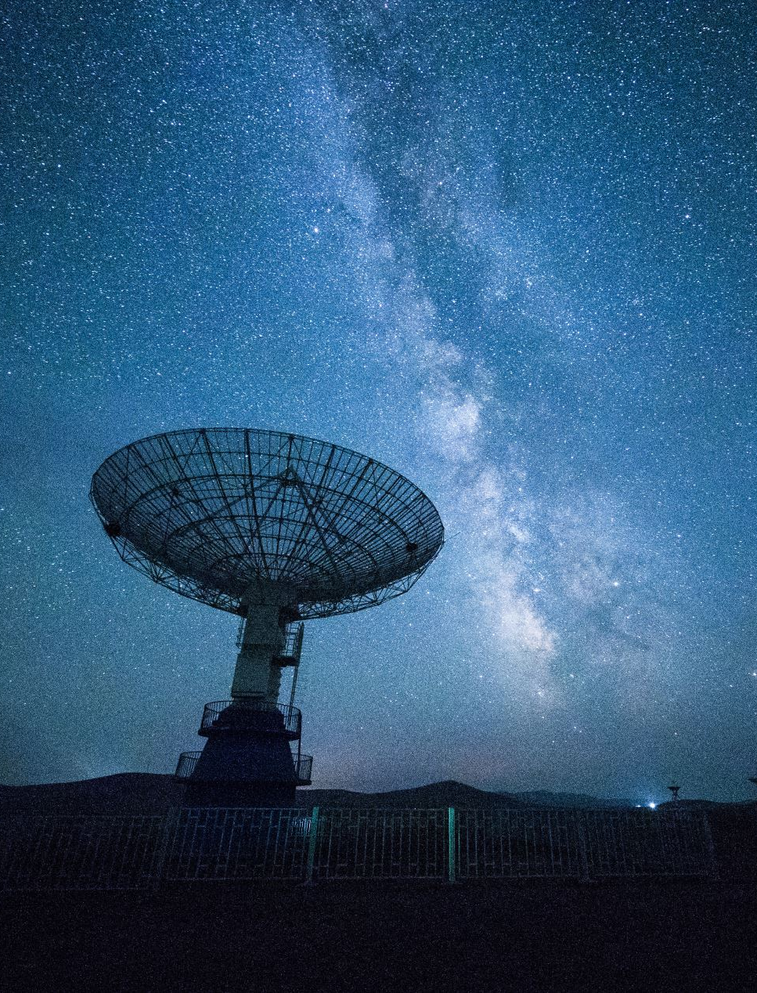

Introduction
From ancient Greek and Roman philosophers through to the invention of the telescope and the birth of science fiction
Mankind has been fascinated by the potential of other worlds and their inhabitants
But why have we been fascinated by this?
We have a desire to know the unknown
“Exploration is wired into our brains. If we can see the horizon, we want to know what’s beyond” – Buzz Aldrin, Magnificent Desolation: The Long Journey Home from the Moon (2009)
Notes:
Humanity has been fascinated by the potential of other worlds and their inhabitants
But why are we fascinated by this?
I believe it is because we desire to understand the unknown which Buzz Aldrin frames perfectly

Slide 3
Introduction
Frank Drake conducted the first search for extra-terrestrial radio transmissions in 1960
Using a chart recorder and a loudspeaker connected to the antenna, Drake collected and stored 150 hours of data on tape
Only static was recorded
But this experiment prompted many more and within a year the first scientific meeting was held to discuss the search of extra-terrestrial intelligence
The era of SETI had begun
Notes:
Frank Drake was fascinated by this question and conducted the first search for ET radio transmissions
He got no results, from this experiment but opened the door for many others to begin searching too
The era of SETI had begun
And this links perfectly because apparently SETI is Alex’s favourite thing

Slide 4
“SETI is my favourite thing” – Alex Caian

Slide 5
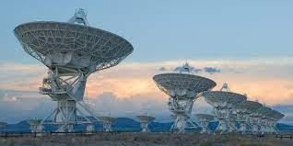
How are we gathering the data?
Still collecting data on extra-terrestrial radio transmissions
Searching for extra-terrestrial laser pulses
Exploring the solar system for signs of life (Mars rovers)
Searching for planets around other stars (exoplanets)
Analysing these planets for potential habitability (could life exist with those atmospheric conditions or are the atmospheric conditions created by life)
Image courtesy of the SETI Institute
Notes:
So how are we gathering data?
We are still looking for radio transmissions but also laser pulses/communications
We are exploring the solar system for other forms of life
And we are finding planets around other stars and analysing their atmospheres for habitability

Slide 6
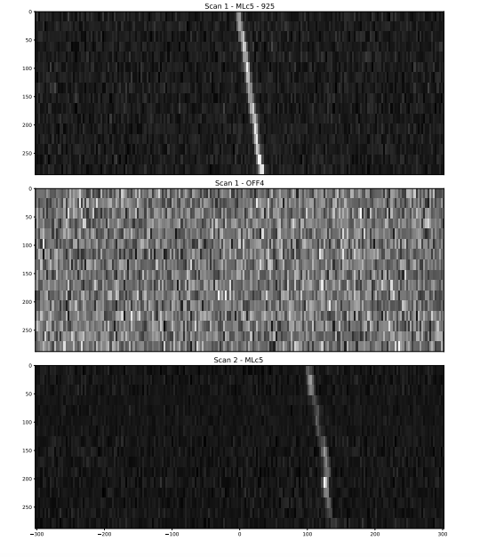
The hunt for radio transmissions
In searching for extra-terrestrial radio transmissions, we look for narrowband signals that occur rarely in nature, hence if such a transmission is discovered it is likely due to intelligent life
Initial searches began around 1.42GHz frequencies but more recently astronomers have been widening this search
As data storage and management solutions have improved this has allowed astronomers to plan more extensive searches
Automated computer programs and machine learning models have been created to sort through the data from these searches and flag any potentially interesting data for human inspection
The search conducted by Margot et al, 2023 looked at an area of sky with 11,680 stars and received 41.2 million signals of which none were thought to be extra-terrestrial
August 1977, the ‘Wow!’ signal was detected – this still has an unknown origin
Limitations: lots of human noise/interference, data storage/management (SKA will collect approximately 300PBs of data per year), ML models could miss potentially interesting transmissions, don’t know the form/frequency of potential ET radio transmissions
Image of a detected radio signal that was flagged for visual inspection. This signal was then deemed to be interference.
Figure 7 from Margot et al, 2023
Notes:
We look for techno-signatures in narrow band frequencies eliminating any naturally occurring radio waves
For each search carried out, many data points are retrieved
For example, a recent study by Margot et al, found 41.2 million signals of which none were thought to be ET
1 exciting result - The Wow signal was detected in 1977 and remains the best chance for an ET signal
Limitations include terrestrial noise, data storage requirements and ML models potentially missing important signals

Slide 7
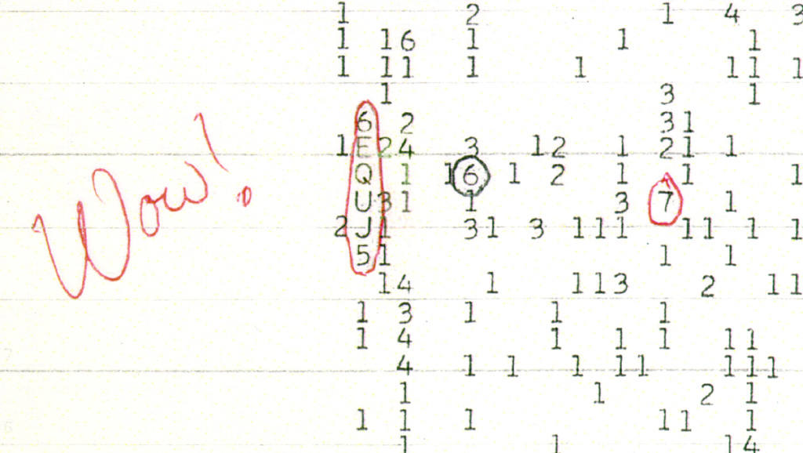
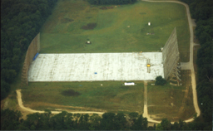
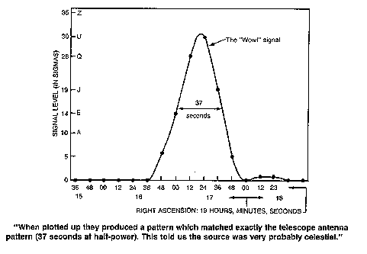
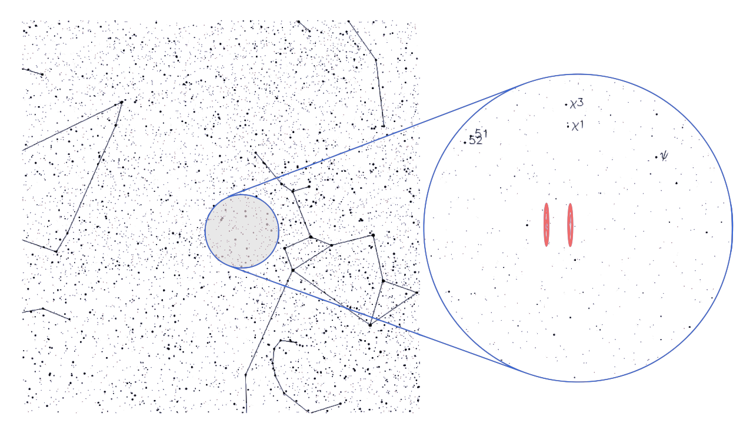
The signal
‘Big ear’ telescope at Ohio state university
The areas of sky the signal likely came from.
17 stars occupy these areas, with 3 being Sun-like
The signal when plotted over time
Images taken from http://www.bigear.org/Wow30th/wow30th.htm and https://en.wikipedia.org/wiki/Wow!_signal
Notes:
Detected in August 1977 by the big ear telescope at Ohio state university
The 6 character string represents the intensity of a detection 1 being lowest, Z being highest
The character represents how many times stronger the signal was compared to the background
Signal peaks around 30 times stronger than the background
It is confirmed to not be of terrestrial origin therefore must be ET in origin
Have searched the same area of sky many times since but found nothing more

Slide 8

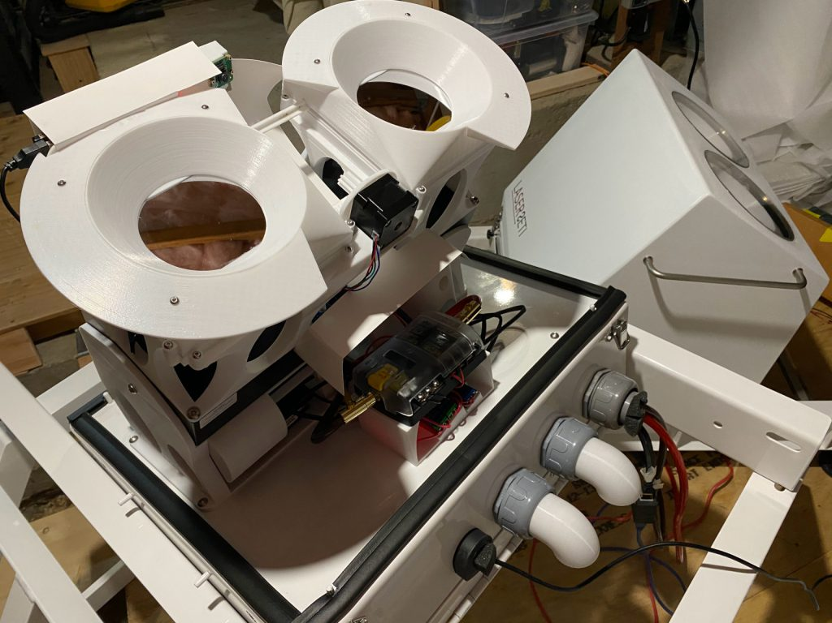
The hunt for laser pulses
Other than the radio spectrum, can we send and receive information using light?
Yes, optical light in the form of lasers (e.g. fibre optics)
If we can do this then it would be a reasonable assumption that another civilization is using lasers to transmit information, and could they be doing this across space?
It is also possible for lasers to be used to propel spacecraft to vast speeds
SETI have designed detectors to look for laser pulses that could be of extra-terrestrial origin
Each detector contains a powerful computer that can analyse the data in real time and remove the need for costly storage or transmission
Limitations: must try to cover whole sky at once with more than one detector covering the same patch for completeness, more than 70% of surface is water, can only observe at night, cannot see through clouds, light pollution
Image taken from https://www.seti.org/laserseti
A laserSETI detector. Image taken from https://laserseti.net/instrument/
Notes:
Using another part of the spectrum, looking for optical pulses
We communicate with optical light therefore we can assume an ETI does too
Detectors have been designed to capture potential pulses and analyse them in real time
Limitations include only being able to observe at night, can’t see through clouds and light pollution can cause noise

Slide 9
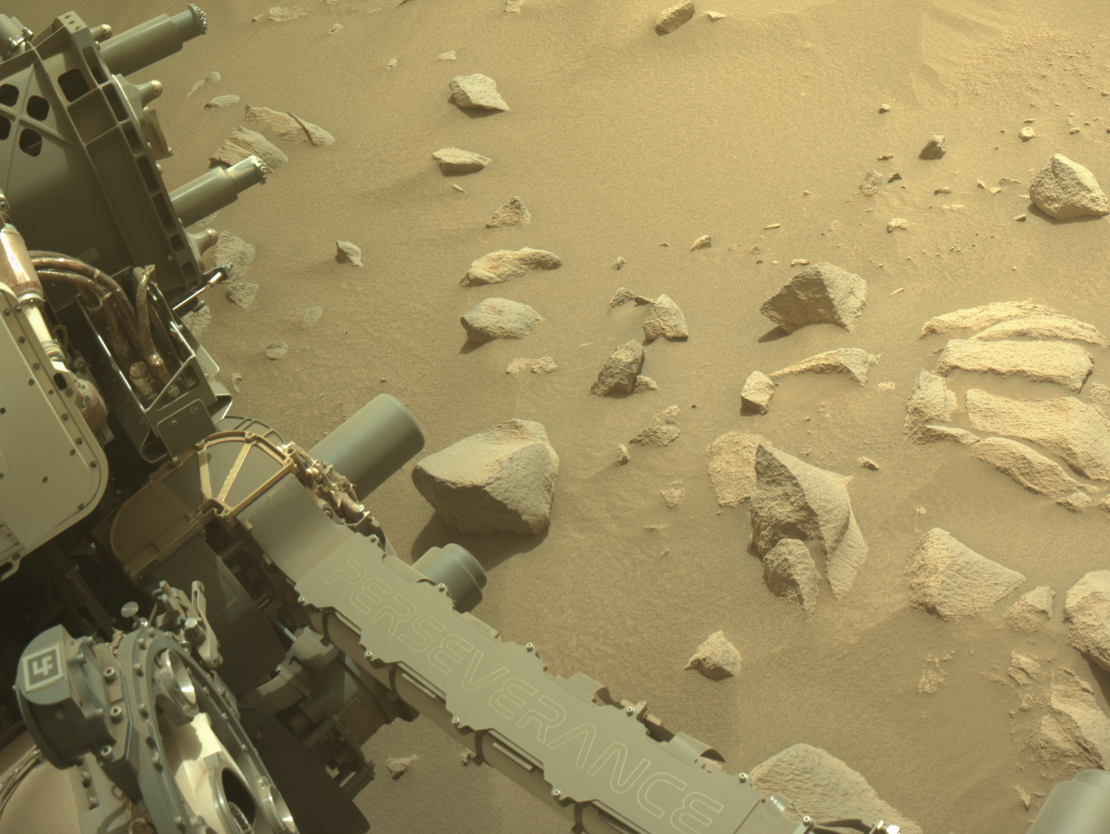
Exploring the solar system
A little bit closer to home, there are some places in the solar system where life could exist other than the Earth e.g. Mars, Europa, Enceladus and Titan
Mars Reconnaissance Orbiter has been relaying real time data of Mars since 2006. Its mission is to understand if water had been on the surface of Mars long enough to provide a habitat for life. In March 2010 it had transmitted 100 terabits of data back to Earth
Perseverance rover, has been on the surface of Mars collecting rock and soil samples searching for signs of microbial life
NASA are planning a mission to Europa (called Europa Clipper set to launch later this year) that will aim to understand what lies beneath its icy surface and whether it could sustain life
Limitations: haven’t sent anything to surface of moons, Europa and Enceladus have thick icy surfaces must get beneath those, likely only to find ancient microbial life on Mars
Image courtesy of NASA/JPL-Caltech, https://mars.nasa.gov/mars2020/multimedia/raw-images/
Notes:
We have been exploring the solar system for more than 60 years now and believe that Mars was once habitable and that moons such as Europa and Enceladus could harbour life
How do we collect data on this?
Satellites have obtained information on the atmospheres and surfaces of these bodies
Rovers have collected samples from Mars but only covering small patches, increasing this area would inevitably increase our chances of finding something and increasing this area to those moons would increase the chances even more
But we are not quite able to get to the surfaces of the moons of Jupiter and Saturn just yet
Europa and Enceladus have icy surfaces, when we get there, we want to get beneath the ice

Slide 10
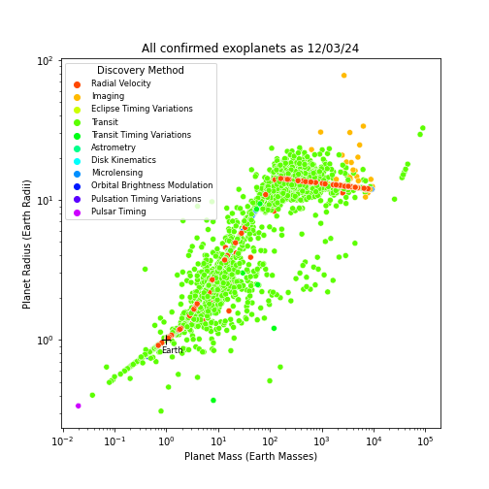
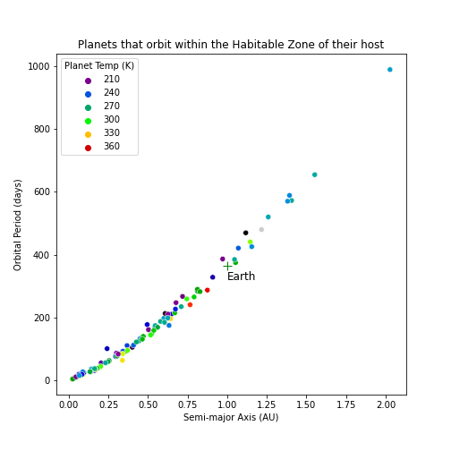
Exoplanets
Since the early 1990’s astronomers have been gathering data on exoplanets
Planets are mainly discovered through indirect observations, observing the effects they have on their host star e.g. dimming the light from the star (transit) and making the star ‘wobble’ (radial velocity)
As of 12/03/24, there were 5599 confirmed exoplanets (according to the NASA Exoplanet Archive, https://exoplanetarchive.ipac.caltech.edu/index.html)
The data gathered includes planet mass, radius, density, orbital period, semi major axis and equilibrium temperature
Limitations: cannot tell if life exists or is immediately habitable, can only observe indirect effects on subsets of stars/planets
Notes:
Been gathering data since 90s
As of 12th March, 5599 confirmed exoplanets – plotted in graph on left
Using data from Exoplanet archive, 204 of these planets orbit in the habitable zone – these are plotted on the right
From these graphs we notice an immediate limitation of this type of study – it’s easier to find the larger planets and those that orbit closer to their star
Hence, we may still be missing out on a large dataset

Slide 11
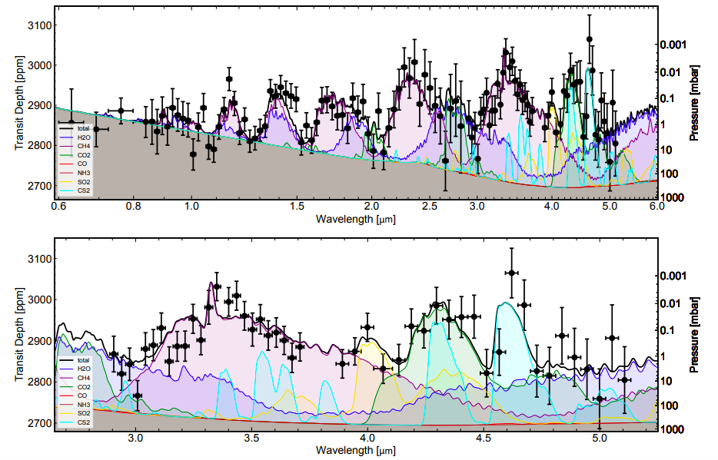
Exoplanet Atmospheres
Measure how the light from the host star is absorbed as it passes through the planets atmosphere on the way to us
The wavelengths at which there is absorption tell us what molecules the atmosphere is made up of
As of 27/03/24, 199 planet atmospheres have been analysed (according to https://research.iac.es/proyecto/exoatmospheres/)
Limitations: planets must transit star, light could be absorbed enroute between planet and earth (ISM, Earths atmosphere), JWST has limited observing time
Planet TOI-270 d absorption spectrum obtained by JWST, with a best-fit model for which molecules make up the atmosphere. Figure 3 from Benneke et al, 2024
Notes:
To understand an exoplanets atmosphere, we measure its absorption spectrum
The wavelengths at which the absorptions occur tell us what molecules are present and in what quantities
From this we can then determine whether the atmosphere is habitable
From a recent study the graphs on the right show the atmosphere of TOI-270d contains methane, CO2 and water
Limitations include only 199 atmospheres have been analysed out of 5599 planets and potential absorptions when light is enroute to Earth

Slide 12
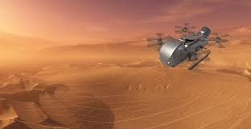
The Future
Increase radio scans – search around exoplanets in habitable zone of their host star, use AI to create synthetic radio signals to simulate what ET radio signals could look like (setigen library in python, Brzycki et al, 2022)
Next era of telescopes – Square Kilometre Array are constructing the two largest radio arrays in the world and will have capability of detecting airport radar 50 light years away, Habitable Worlds Observatory will be the first telescope designed specifically to search for signs of life on other planets
Future NASA (or other space agencies) missions to solar system bodies to search for life – Dragonfly will be a small helicopter-type vehicle that will go to Saturn’s moon Titan and explore its habitability, Mars Sample Return will aim to bring the soil samples from the Perseverance rover back to Earth for more extensive study
Image courtesy of NASA
Notes:
Search for radio transmissions around exoplanets in habitable zones – most likely places for life to form
Use AI to create synthetic radio signals – could increase performance of ML models
New era of telescopes – SKA will have ability to detect airport radar 50 light years away, HWO first telescope designed specifically to search for signs of life
Dragonfly with go to Titan and explore its habitability
Drill beneath the surfaces of Europa & Enceladus and examine samples retrieved
Mars Sample Return will aim to bring some samples collected by Perseverance back to Earth for study

Slide 13
Summary & Final Thoughts
We have, are and will continue to collect vast amounts of data to get an answer to this age-old question
But with all this data, we have one piece of evidence – the ’Wow!’ signal
There are limited amounts of time and resources that can be spent searching for ETIs as well as many other current limitations
Do you want to be a part of the search? https://www.zooniverse.org/get-involved & https://www.zooniverse.org/projects/ucla-seti-group/are-we-alone-in-the-universe/about/research
I believe that there are other civilizations out there, but I don’t think we will discover one in my lifetime
Notes:
With all the data we have collected – only one result
This is disheartening but the search will continue until we can answer the question
I believe that there are other civilizations in the Universe, I believe the Wow signal is from one of those civilizations but the distances between us mean that we won’t hear from them again in my lifetime

Slide 14
Thank you for listening Are there any questions?

Slide 15
References
https://slate.com/human-interest/2014/08/when-did-humans-first-consider-the-possibility-of-alien-life.html
https://sgp.fas.org/othergov/doe/lanl/la-10311-ms.pdf
https://www.seti.org/project-ozma
https://en.wikipedia.org/wiki/Project_Ozma
https://www.seti.org/seti-allen-telescope-array-ata
Margot, J.L., Li, M.G., Pinchuk, P., Myhrvold, N., Lesyna, L., Alcantara, L.E., Andrakin, M.T., Arunseangroj, J., Baclet, D.S., Belk, M.H. and Bhadha, Z.R., 2023. A Search for Technosignatures Around 11,680 Stars with the Green Bank Telescope at 1.15–1.73 GHz. The Astronomical Journal, 166(5), p.206. https://arxiv.org/pdf/2308.02712.pdf
https://www.skao.int/en/explore/big-data
https://laserseti.net/
https://www.nasa.gov/missions/
https://exoplanetarchive.ipac.caltech.edu/index.html
Brown, T.M., Charbonneau, D., Gilliland, R.L., Noyes, R.W. and Burrows, A., 2001. Hubble Space Telescope time-series photometry of the transiting planet of HD 209458. The Astrophysical Journal, 552(2), p.699. https://iopscience.iop.org/article/10.1086/320580/pdf
https://research.iac.es/proyecto/exoatmospheres/
Benneke, B., Roy, P.A., Coulombe, L.P., Radica, M., Piaulet, C., Ahrer, E.M., Pierrehumbert, R., Krissansen-Totton, J., Schlichting, H.E., Hu, R. and Yang, J., 2024. JWST Reveals CH $ _4 $, CO $ _2 $, and H $ _2 $ O in a Metal-rich Miscible Atmosphere on a Two-Earth-Radius Exoplanet. arXiv preprint arXiv:2403.03325. https://arxiv.org/pdf/2403.03325.pdf
Brzycki, B., Siemion, A.P., de Pater, I., Croft, S., Hoang, J., Ng, C., Price, D.C., Sheikh, S. and Zheng, Z., 2022. Setigen: Simulating Radio Technosignatures for the Search for Extraterrestrial Intelligence. The Astronomical Journal, 163(5), p.222. https://arxiv.org/pdf/2203.09668.pdf
https://science.nasa.gov/astrophysics/programs/habitable-worlds-observatory/

